Slide 1
Angular (v14* - TIAA) & Micro Front End Application Session3 1/Sep/2023
Paul

Slide 2
Session Objective
Angular template
Four types of Data bindings in Angular
Architecture of Angular
SPA in Angular
Implement SPA in Angular

Slide 3
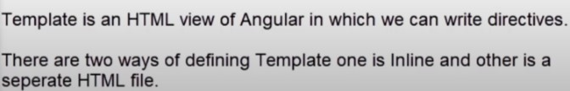
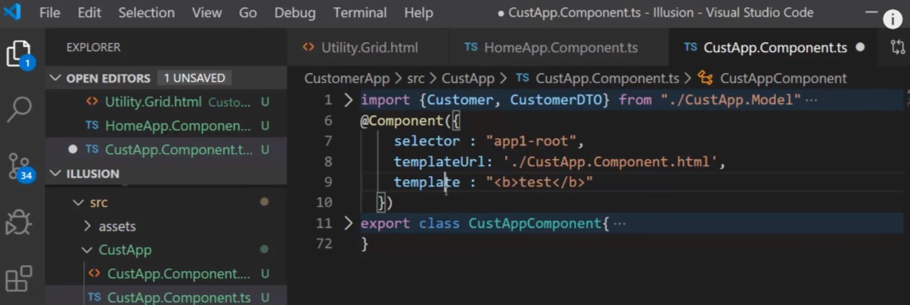
What is template?

Slide 4
Four types of Data bindings in Angular
Data Binding in Angular defines how the view and component each other

Slide 5
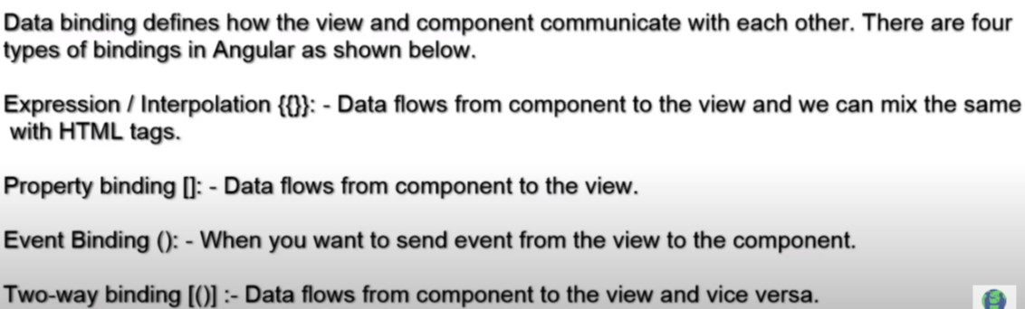
Four Types of binding

Slide 6
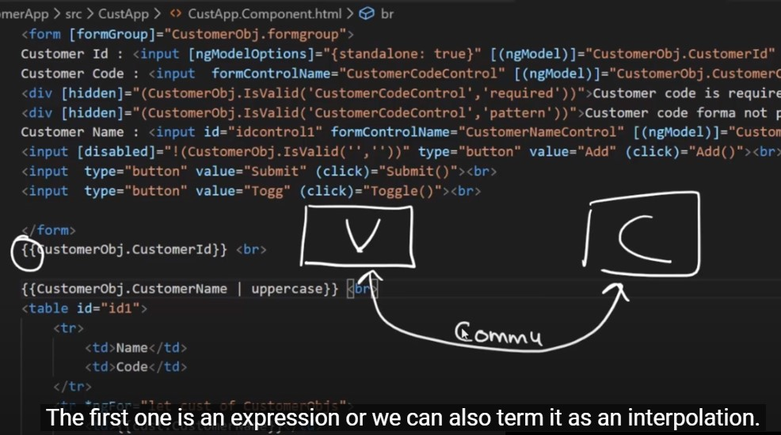
Four types of Data bindings in Angular

Slide 7
Four types of Data bindings in Angular

Slide 8
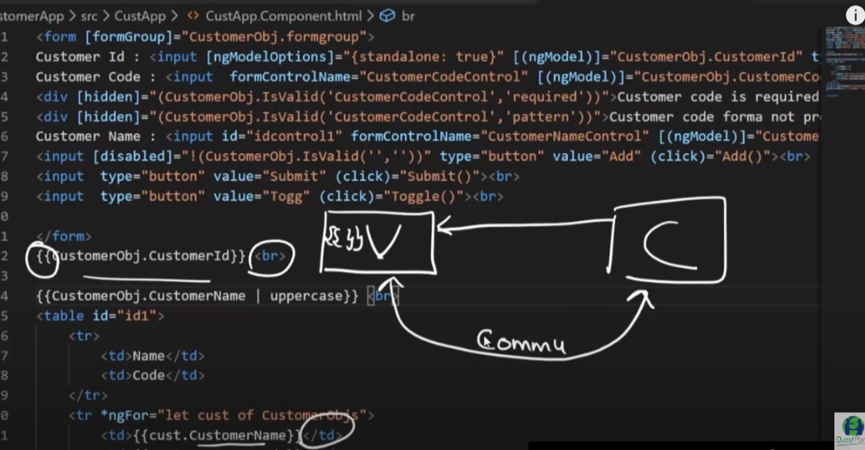

Slide 9
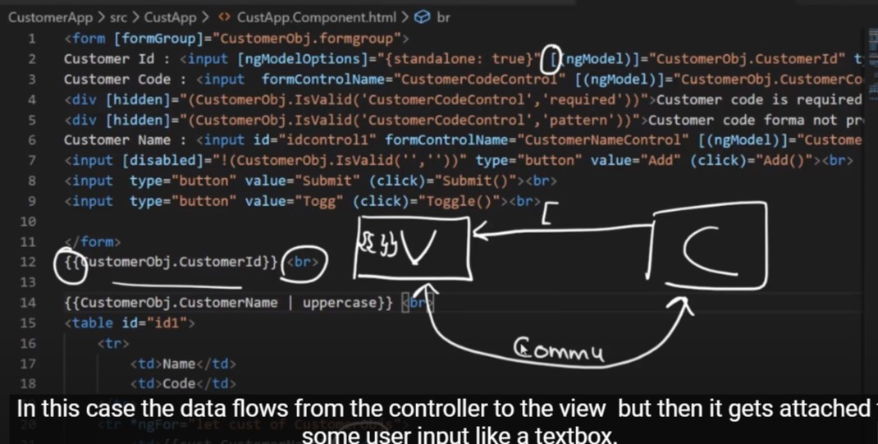
Property binding

Slide 10
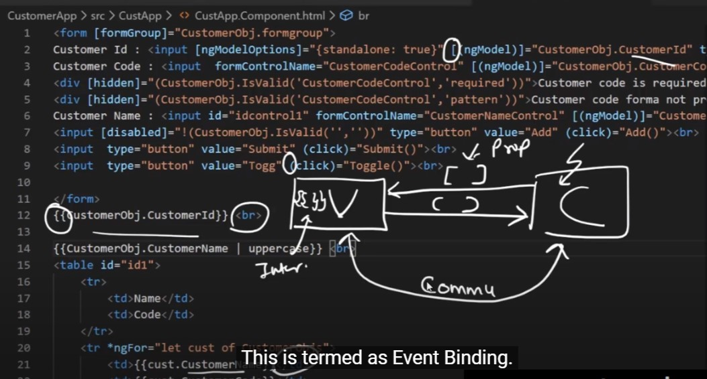
Event binding

Slide 11
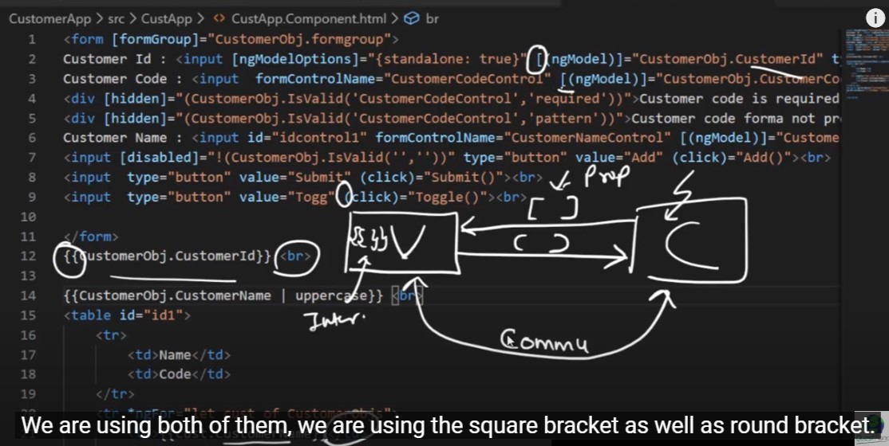
Two way binding

Slide 12
Architecture of Angular

Slide 13
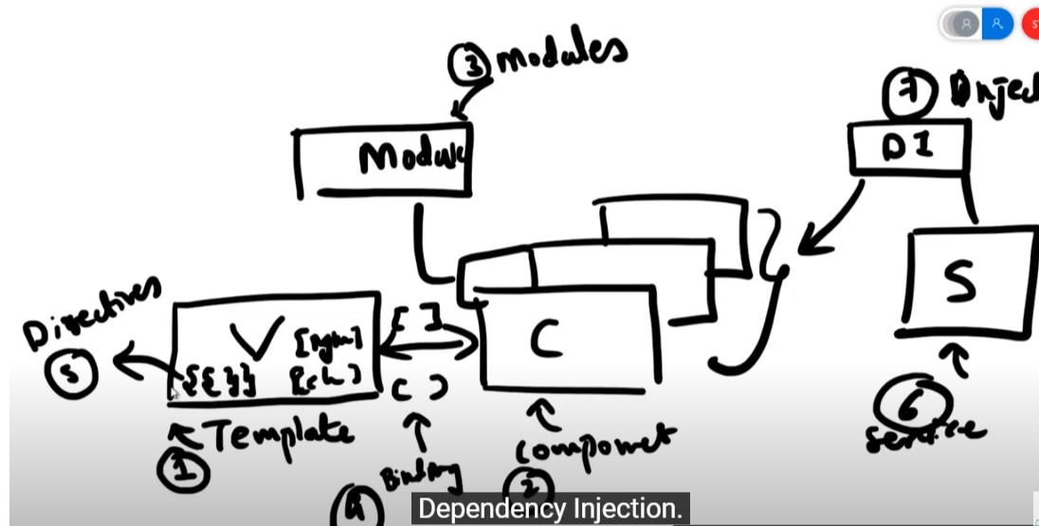

Slide 14
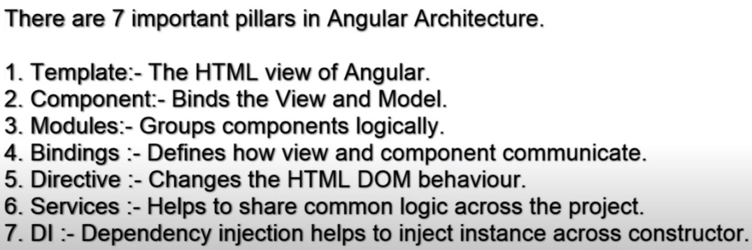

Slide 15
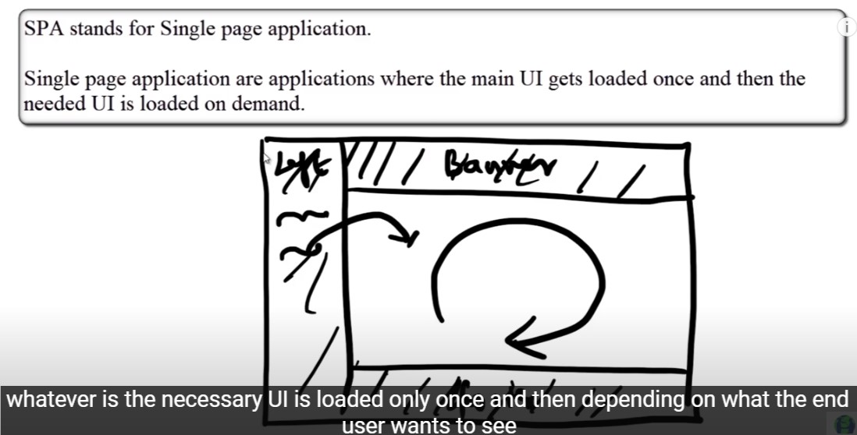

Slide 16
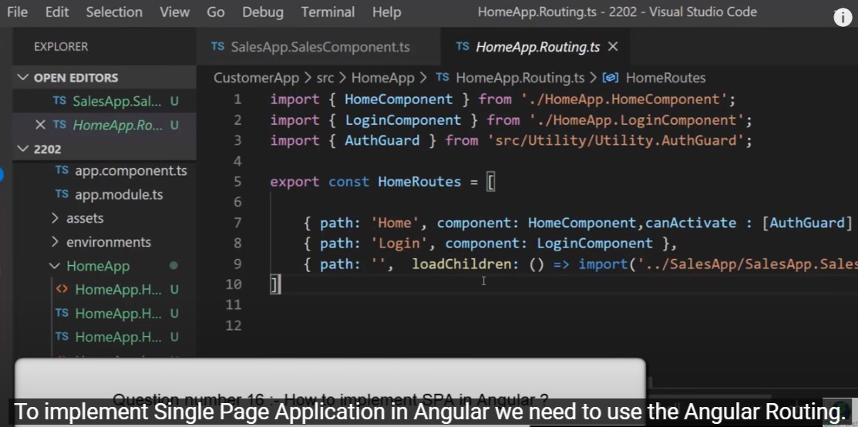

Slide 17
Live Demo

Slide 18
Knowledge Check

Slide 19
1) Decoratives changes html DOM Behaviour? true or false >2) when you want to send any event from view to the component is called event binding? true or false 3) is this correct syntax ng newapp angular-lazy-loading-example --routing --style=css --skip-tests? true or false

Slide 20
Q & A

Slide 21
Thank you
Thank you!

